Slide 1


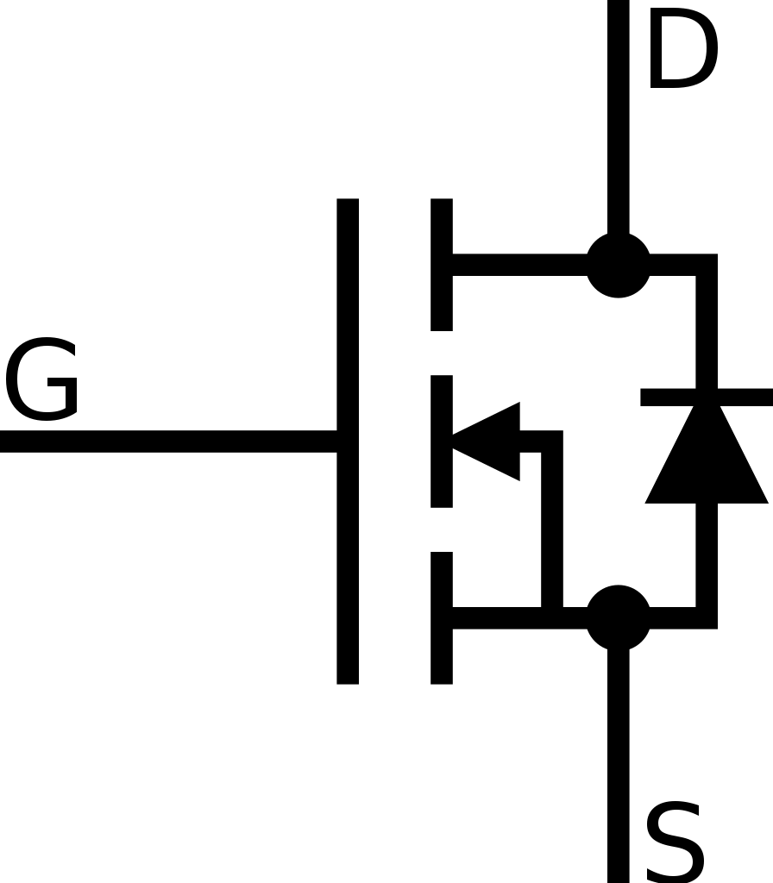


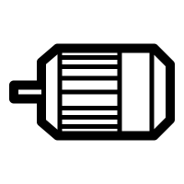



PROJECT ELECTRIC VEHICLE (EV)
MOTOR CONTROLLER & POWER ELECTRONICS
Presentation by: Carl Sagrado
Notes:
For those who doesn’t know me my name is Carl Sagrado and for those who know me – “howareyall?!” Image Reference : This Photo by Unknown Author is licensed under CC BY-SA This Photo by Unknown Author is licensed under CC BY-SA

Slide 2
PRESENTATION TOPICS
04
01
02
05
03
PROJECT OVERVIEW
PROJECT PROGRESS
- General Project Scope - Motor Controller
- Current Progress - Future goals
SUMMARY
PWM & DC Motor
- Lynch DC Motor
- PWM - Torque
- Presentation summary
MOSFET & DRIVER
- Power MOSFET - MOSFET driver - Signal Isolation
Notes:
My presentation topic will encompass 6 sections, namely Project overview, DC motor, MOSFET and DRIVER Signal isolation, progress, and finally summary.

Slide 3



ELECTRIC VEHICLE
01
PROJECT OVERVIEW
PROJECT EV
MOTOR CONTROLLER
MCU
CAN BUS
BMS
Master Control Unit
Controller Area Network
Battery Management System
Motor Controller & Power Electronics (Carl Sagrado)
Notes:
THE PROJECT EV encompasses 4 sections of the project, assigned to different groups to develop the parts which will be combined together at the end to work as a whole. These sections are ,
MCU – responsible for calculating and sending signals
CAN – Network controller responsible for handling the communication side of the EV
BMS – Manages and maintain governance over battery behaviour ensuring optimal power supply is provided
MC – Responsible for DC Motor operation and control (By Xi Cheng and yours truly - which is what this presentation is all about)
- These sections are divided and assigned to different groups to develop the parts to which will be interlinked together as a whole at the end. A motor controller is a device used to govern the behaviour motor. It is a circuit that function as an interface between the signal from the master control and the Motor. We could also define it as a device that regulates the movement of a motor.

Slide 4
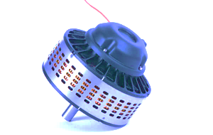
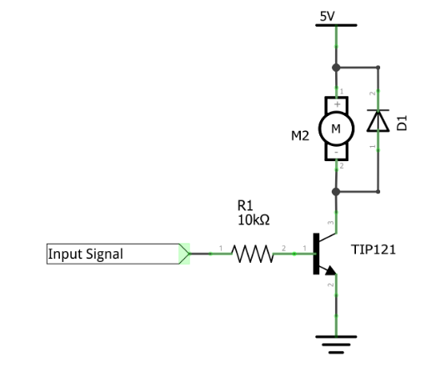
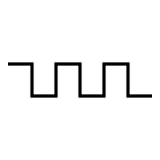
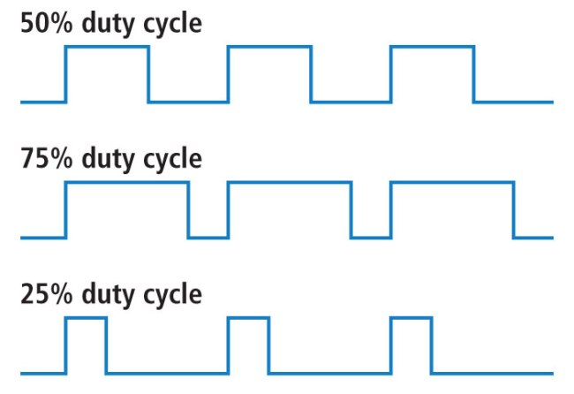
Lynch DC Motor
02
PULSE WIDTH MODULATION
Refers to as “Pancake Motor”
High capacity power output up to 21KW on 12V to 120V
We aim to run this motor at 36V
Flyback diode to maintain the flow of current in one direction
PULSE WIDTH MODULATION – PWM
With PWM, we can limit current flow across the transistor to control the motor by switching the connection between source and load at a fast rate. Thus allowing control of the amount of power being delivered to the motor from the power source.
PWM duty cycle allows us to define the amount of time for the signal to stay in a high state as a percentage to the total time of the signal.
This Photo by Unknown Author is licensed under CC BY-NC-ND
PWM - Frequency and Duty Cycle
Notes:
Let us briefly discuss the component we aim to control and how we are going to control it.
A DC motor is a type of electrical machine that transforms electric energy into a mechanical energy in a form of rotation.
The key concept of its rotation, is the positioning of the electromagnet within the field of the permanent magnets. When a current is present in the conductor , it produces an electromagnetic field which reacts to the magnetic field of the magnets – this reaction causes repulsion and attraction which results in the torque that makes the motor spin.
Reversely, when current is absent and physical action is made to rotate the motor, it behaves like a power generator.
For us to control the torque or the speed of rotation of the motor, we would need to regulate the flow of current across the motor.
We can achieve this by manipulating the amount of time the motor is on and exposed to current with the use of PWM signal.
PWM signal is a process which allows us to control the switching connection between source and load at high rate.
The duty cycle as you see in the diagram allows us to define the amount of time for the signal to stay ‘on’ as a percentage of the total time of one full cycle.
The schematic shows the initial testing and the observation of the influence of PWM as we fed the signal to the base of a power transistor.
Side note: You may notice a diode connected in parallel with the motor, this diode is a flyback diode specifically placed to maintain the flow of current in one direction.
As we progress to a higher load and higher voltage and current level, we needed to replace the typical npn transistor with a more capable and suitable transistor called MOSFET.

Slide 5
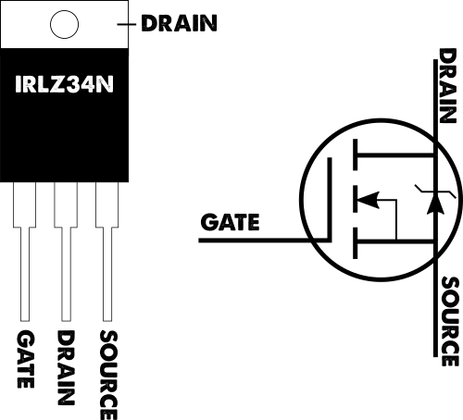
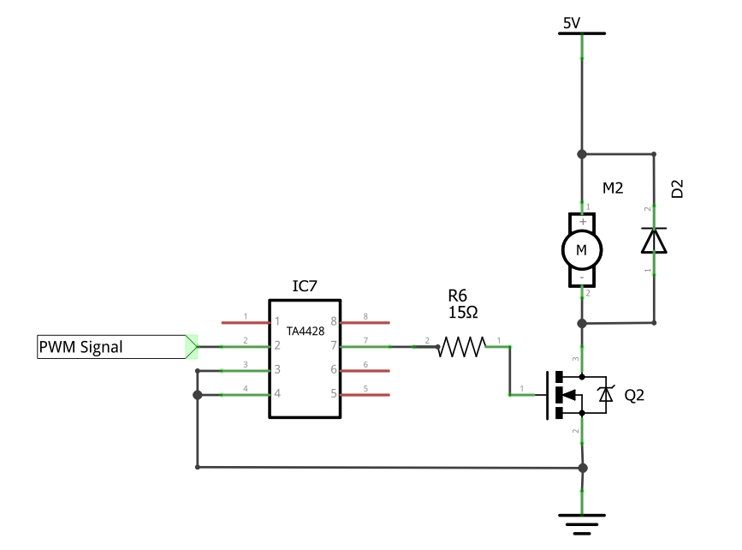
03
MOSFET & MOSFET DRIVER
MOSFET (N TYPE)
Metal Oxide Semiconductor Field Effect Transistor
Enhancement Type - “Normally Open”
Device widely used for switching and control application.
Voltage driven and controlled by inducing voltage to the gate
This device has a very low resistance at the gate and capable of operating up to 175°C a widely used device for automotive applications
IXTY64N055T
Specialized IC circuit used to drive the gate of Power MOSFETs to switch the device on/off.
Translates periodic signal to a higher voltage and high current, to rapidly switch the gate of a MOSFET.
Maximises the switching speed by providing significant amount of current to the gate to satisfy and address rise/fall time as well as switching delays.
Minimises power dissipation.
This Photo by Unknown Author is licensed under CC BY-NC-ND
MOSFET DRIVER
PWM with MOSFET & Driver
Notes:
MOSFET is a type of transistor that is specifically built for switching and control operation. Compared to an NPN transistor – current driven, MOSFET is a voltage driven which means we only need specific voltages to switch the device on or off. The one we used for the initial development of motor control prototype is a enhancement type device which is also referred to as “Normally Open”. This device has a very low resistance at the gate and can easily be controlled and capable at operating up to 175 degrees celcius, a proven and used device for automotive applications.
There were issues pertaining the use of MOSFET as we progress to increase supply of power to our motor – “to make it spin faster and stronger” –specifically in relation to the PWM signal, we needed to regulate the voltage level to work with the PWM to correctly maintain the switching and at the same time, the switching speed (Which involves a large amount of current to feed to the gate to satisfy the charging and discharging of the capacitance gate) and thus we employed a specific device called a MOSFET driver – This device is specifically built to address the conundrums I just mentioned and are capable at driving the mosfet hard to fully switch on and off with a short amount of time. Due to its low resistance at the output and the low resistance at the gate, this also addresses the issue in relation to power dissipation at the gate as MOSFET is switches at a very fast rate.
The next thing we are going to look at is how we are going to isolate the signal, PWM signal typically operates up to 3.3V and since we want to supply our motor to up 36 volts with high amount of current – we needed to isolate the two power source,

Slide 6
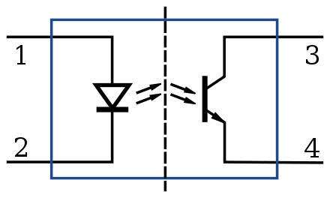
04
SIGNAL ISOLATION
OPTOISOLATOR
The application demands power source greater than that of a microcontroller could handle and thus two electric signals need to be isolated.
The purpose of the optoisolator for our application is mainly to protect and maintain the original signal level transmitted from the master control to be translated by the MOSFET driver to switch the power MOSFET on/off
Its operation is based on the voltage induced by the power source of the transmitting circuit, to produce a near-light beam which will travel across the channel to the sensor which will translate the optical energy to electrical energy.
Optoisolator Internal Diagram
Notes:
To isolate the power source, we used an optocoupler – its operation is based on optical transmission.
Any voltage signal induced in the input pin will produce a light beam which will travel across the channel and be detected and translated through a sensor which will then be converted into electrical energy. Successfully separating the two sources, we were able to finally test the prototype system which is shown in the next slide.

Slide 7
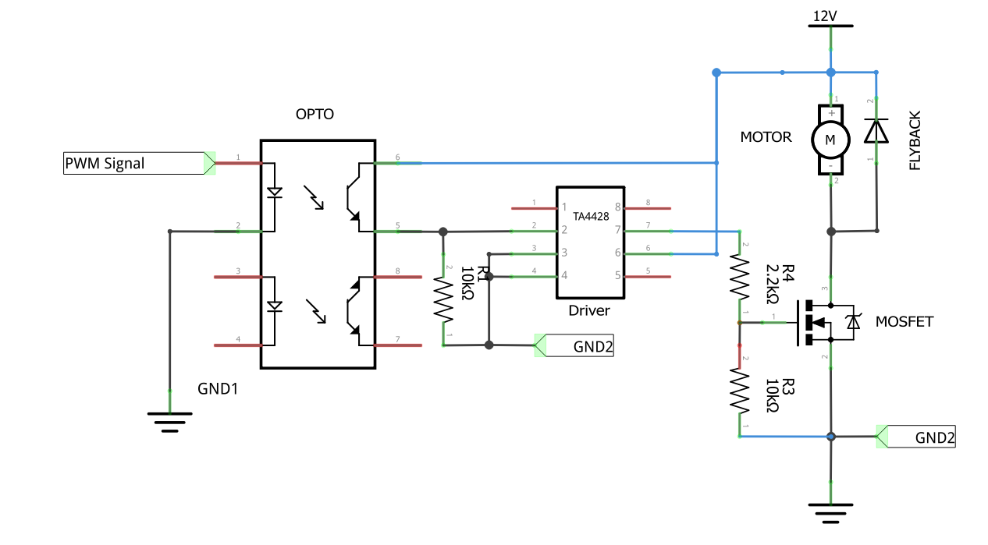
JAN ‘20
END
04
HERE WE ARE
SIGNAL ISOLATION
FEB ‘20
MAR ‘20
APR ‘20
Aux source
Battery source
Notes:
So here we are, as you can see the two sources is isolated.
The PWM signal will be fed at the input – detected at the other side, which will be fed to the input of the MOSFET driver and down to the MOSFET.
Varrying of the signal depending on the signal symmetry (ON: percentage) causes the mosfet to turn on and off at a very fast speed allowing us to control the motor.

Slide 8

05
1) Current Progress
CURRENT PROGRESS, CHALLENGES & FUTURE ACTIONS
The working concept of the motor controller was built & proven to be working according to desired output.
Circuit is operational at up to 32V and 1.6A current
PWM signal is manipulatable between 0% up to 90%
Circuit is isolated
Translated pulse signal from the source matches the output produced by the MOSFET driver
JAN ‘20
END
FEB ‘20
MAR ‘20
APR ‘20
Long period of operation causes MOSFET to heat quickly
Resistance value used between MOSFET driver and MOSFET requires further investigation for power optimisation
Future Actions (3
Incorporate fibre optic links to send/receive information to/from the MCU
Addition of current sensor to measure and provide optimum torque performance.
Address issues relating thermal condition at MOSFET.
Develop a power section to handle power dissipation for the power stage to handle large amount of current during vehicle driving operation (E.g. addition of power MOSFETs, power diodes, storage capacitors for soft start)
Test controller capabilities with EV Battery.
Integrate Motor Controller to the rest of EV parts..
This Photo by Unknown Author is licensed under CC BY-NC-ND
2) Challenges
Notes:
So our current progress,
Following testing, we now have a working concept of a motor controller. It was built tested and proven to output desired result
Circuit can operate up to 32V and (safeside) 1.6A current (We will talk more on that in the next section)
PWM signal works and we are able to retrieve the pulse signal from the other side of the isolated area.
It wasn’t all easy and straightforward – along the way we did encounter few issues which required modification of the previous model. The main issues so far are mainly, POWER stage section – our MOSFET heats up too quickly (understandably due to current present between drain to source. Resistance value used between MOSFET driver and MOSFET requires further investigation to optimise power efficiency.
Thus for future actions we are going to address the above and also add a few more parts to attain effect motor controller system . We are going to ----------

Slide 9
6) SUMMARY
Project scope
PWM to control the motor
Power stage (MOSFET & MOSFET driver)
General concept of circuit operation
Next developments
Notes:
In summary, we’ve discussed the scope and requirements involve for this project- we talked about PWM and how it relates to motor control –
We went through the operation of the DC Motor and the relative components used for the motor controller.
We discussed about the power stage and why we use MOSFET and MOSFET driver for this project.
Circuit isolation was briefly discussed and the importance of it and finally, what we aimed to do for future development of the Motor Controller

Slide 10
THANKS
Carl Sagrado x00084403@mytudublin.ie
+353 86 663 0136 Electronic Engineering Department 3rd Year – Semester 5
Project Partner: Xi Cheng
….
Notes:
I hope - I somehow satisfied your curiosity, my name is Carl Sagrado and thank you for your time. **END**

Slide 11
THANKS
Carl Sagrado x00084403@mytudublin.ie
+353 86 663 0136 Electronic Engineering Department 3rd Year – Semester 5
Project Partner: Xi Cheng

